Slide 1
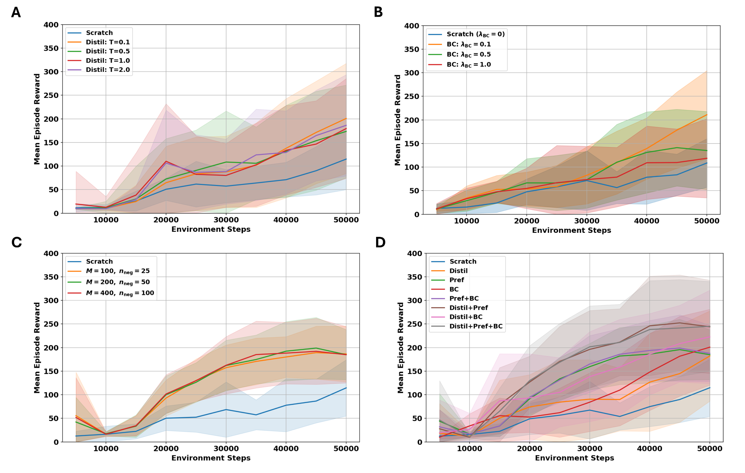
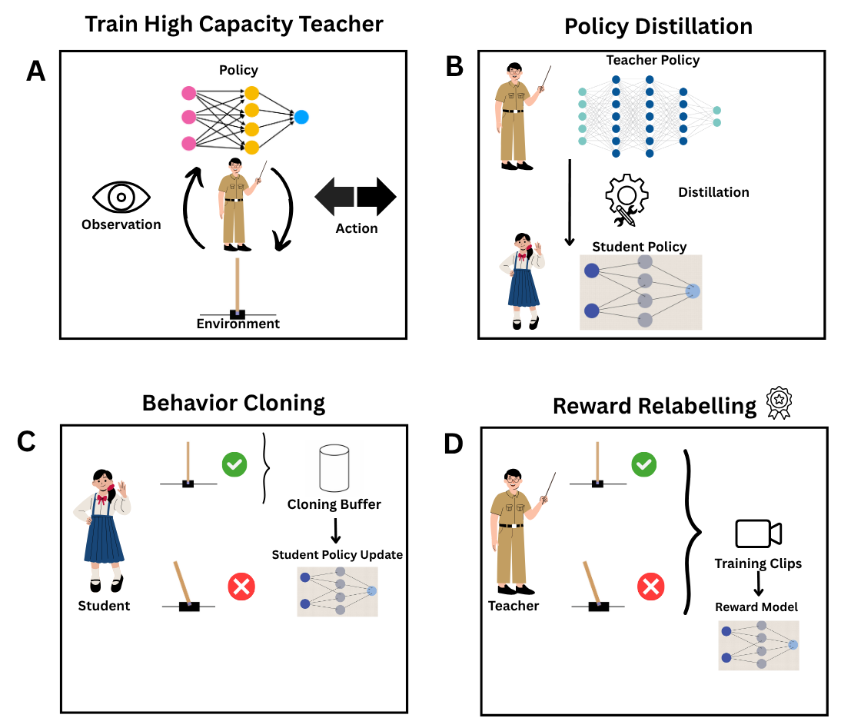
Teacher-Guided QR-DQN: Distillation, Preference Relabeling and Behaviour Cloning
Doruk Akay
Bachelor Thesis - Vrije university
Abstract
This thesis introduces a teacher-guided reinforcement learning approach that combines policy distillation, preference-based reward relabelling, and behaviour cloning to improve sample efficiency. A strong QR-DQN teacher is trained once and used to supervise a compact student agent. By distilling its decisions, training a reward model from ranked trajectories, and encouraging imitation of high-reward actions, the student achieves high performance with far fewer interactions.
Introduction
Results
Reinforcement learning allows agents to learn through trial and error, but its success often comes at the cost of extensive interaction data, limiting its feasibility in real-world settings. One promising solution is teacher-guided learning, where a pre-trained expert accelerates the training of a smaller, more efficient student agent. This work introduces a framework that combines three complementary strategies: policy distillation, which transfers the teacher’s action preferences to the student; preference-based reward relabeling, which transforms sparse feedback into a dense reward signal based on ranked trajectories; and behaviour cloning, which regularizes the student’s updates using high-value actions from the teacher. These methods are unified within a Quantile Regression DQN (QR-DQN) architecture, which models the full distribution of future returns to improve learning precision and uncertainty estimation. This study investigates how the combined use of these guidance strategies affects the sample efficiency, learning stability, and overall performance of the student, asking: To what extent can policy distillation, preference-based reward relabeling, and behaviour cloning—when integrated into a distributional RL pipeline—jointly enhance the learning capabilities of a compact QR-DQN agent?
All teacher-guided methods improved both sample efficiency and final performance over training from scratch.
Policy distillation consistently accelerated early learning across all temperature values, with the best results at T = 0.1(see Figure A).
Behavior cloning enhanced convergence, especially when using a low loss coefficient (λ = 0.1), helping the student imitate without sacrificing exploration (see Figure B).
Preference-based reward relabeling proved effective, as increasing preference labels led to denser and more useful reward signals, improving learning speed (see Figure C).
Combining all strategies—distillation, preferences, and cloning—resulted in the best overall performance, significantly outperforming all individual methods (see Figure D).
These results highlight a strong synergy when multiple forms of teacher guidance are used together and affirm that combining teacher-guided strategies leads to more stable, efficient, and high-performing student policies than any individual method alone.
Materials & Methods
This thesis examines four student agent variants trained with varying degrees of teacher supervision in the CartPole-v1 environment. As shown in the diagram, the process begins by training a high-capacity QR-DQN teacher on 200,000 steps. The student agents—smaller QR-DQN models—learn either from scratch or with guidance. In the policy distillation phase (Figure B), the student aligns its outputs with the teacher’s using KL divergence over stored states. In reward relabeling (Figure D, the sparse environment rewards are replaced with dense signals from a reward model trained on ranked teacher trajectories. Lastly, in behavior cloning (Figure C), transitions with high rewards are stored and reused to guide the student toward teacher-like actions through cross-entropy loss.
Discussion & Conclusion
The results confirm that each teacher-guidance method improves learning over standard reinforcement learning. Distillation offers strong priors, preference-based rewards overcome sparse feedback, and behaviour cloning accelerates action alignment. When combined, these strategies act complementarity—each solving a unique bottleneck. The tri-modal model achieves the highest average reward with the most sample-efficient learning curve, supporting the research question that such integration significantly enhances compact agent performance.
References
Mnih, V. et al. (2015). Human-level control through deep reinforcement learning. Nature, 518(7540), 529–533.https://doi.org/10.1038/nature14236
Dabney, W. et al. (2018). Implicit quantile networks for distributional reinforcement learning. In ICML.
Christiano, P. et al. (2017). Deep reinforcement learning from human preferences. In NeurIPS.
Hinton, G. et al. (2015). Distilling the knowledge in a neural network. arXiv preprint arXiv:1503.02531.
Oord, A. v. d. et al. (2018). Representation learning with contrastive predictive coding. arXiv preprint arXiv:1807.03748.

